Slide 1
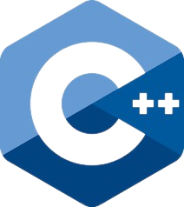
CapacityBay C++ COURSE DANIEL EMEKA - ILOZOR

Slide 2
#5 Arrays and Strings

Slide 3
TABLE of contents
Arrays
Strings Plus Errors
Multi-Dimensional Arrays

Slide 4
01 ARRAYS

Slide 5
ARRAYS
Say we want to store the test scores of 10 students in a class in C++. We could create 10 different variables for each student, but that wouldn’t be fun to code. What happens if there are 30 students? How about 100? This is where arrays come in.
An array is a fundamental data structure that allows you to store multiple elements of the same data type under a single variable name. Think of it as a row of variables where each variable can hold a value, and you can access any variable using its position number in that row.

Slide 6
Accessing elements in arrays
An array is a way to organize and manage a collection of data e.g.(ints, chars, floats…).
Each individual data item in the collection is called an "element." To work with these elements, we use the concept of indexing. When you want to access a specific data item (element) within an array, you use an index. Think of an index as a label that tells you the position of an element within the array.

Slide 7
ZERO-BASED INDEXING
In many programming languages, including C++, array indexing starts from 0. This means that the first element is assigned an index of 0, the second element has an index of 1, and so on.
For example, let's say you have an array of scores:
The score 80 is at index 0.
The score 90 is at index 1.
The score 70 is at index 2.
The score 85 is at index 3.

Slide 8

Why Zero-Based Indexing?
Zero-based indexing might seem counterintuitive at first, but it has several benefits in programming.
It aligns well with memory addressing in computers and makes calculations simpler.
While it might take a little getting used to, it becomes second nature with practice.

Slide 9

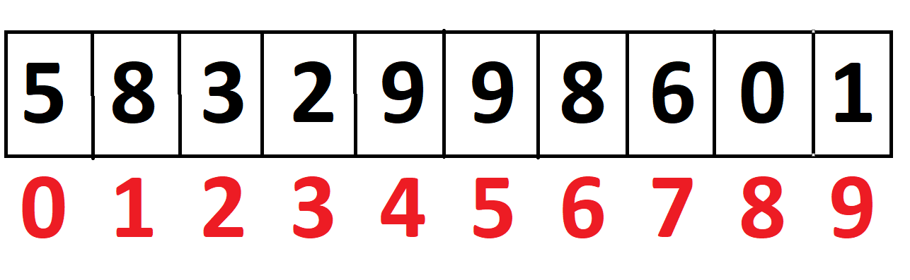
DECLARING ARRAYS
To create an array, you declare its type followed by its name and the number of elements it can hold. For example: int numbers[5];
Initialization: You can also initialize the array with values when declaring it:

Slide 10
DECLARING ARRAYS 2
#include <iostream>
using namespace std;
int main() {
int arr[100]; // Declaring an array without initializing
int numbers[5] = {1, 2, 3, 4, 5}; // Initialize with values
int scores[10] = {10, 20, 30}; // First three elements are initialized, rest are 0
int ages[] = {18, 25, 30, 22}; // Array size is automatically set to 4
int counts[5] = {}; // All elements are initialized to 0
char message[] = "Hello"; // Initialize a character array (like a string)
double points[] = {1.0, 4.0, 6.9, 4.2}; // An array of doubles
const int SZ = 10;
int Arr[SZ];
//Arrays must have a fixed size and hence you cant use a variable to declare its
//size. CONSTANT VARIABLES CAN BE USED AS THEY CANT CHANGE VALUE
}

Slide 11
ACCESSING ELEMENTS IN ARRAYS
#include <bits/stdc++.h>
using namespace std;
int main() {
int num[10] = {}; // sets all to 0 at the start
/* We use [] to access a particular index of an array
To access the xth position of num[], use num[x-1]
Remember, we start counting from 0!!!
*/
num[0] = 5; // assign 5 to the element at index 0
cout << num[0] << "\n"; // 5
num[1] = 6; // assign 6 to the element at index 1
cout << num[1] << "\n"; // 6
num[2] = num[0]+num[1]; // assign 5+6 to the element at index 2
cout << num[2] << "\n"; // 11
num[3] = num[1]*num[2]; // assign 6*11 to the element at index 3
cout << num[3] << "\n"; // 66
cout << num[0]+num[1]+num[2] << "\n"; // print the sum of the first 3 elements: 22 }

Slide 12
02 S-T-R-I-N-G-S PLUS ERRORS

Slide 13
S-T-R-I-N-G-S
The term "string" in programming is related to how characters are "strung" or arranged together in a linear fashion, much like beads on a string. This concept reflects how characters are stored sequentially in memory to form a sequence of text.
In C++, strings are essentially treated as arrays of characters. Each character in the string is stored in a consecutive array element. This relationship allows you to use various array-related concepts and operations when working with strings.

Slide 14
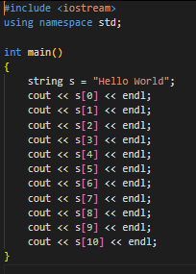

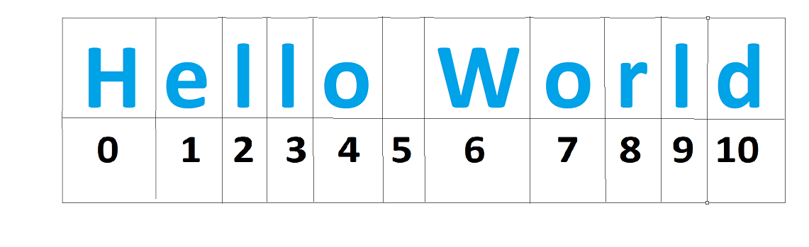
STRINGS AS ARRAY
Each character of a string is an element of the string(which is basically an array of characters).

Slide 15

The PluS OPERATOR (+)
The ‘+’ operator is used to concatenate (join) two strings together, creating a new string that contains the characters from both input strings in the order they appear.

Slide 16
The PluS Assignment OPERATOR (+=)
The ‘+=’ operator is a shorthand for the plus operator. Similar to its usage with other variables.
#include <iostream>
using namespace std;
int main()
{
string a = "Hello";
string b = "World";
a+=b; cout << a << "\n"; //HelloWorld
a = "Hello "; a+=b; cout << a << "\n"; //Hello World
a = "Hello"; a+=" "+b; cout << a << "\n"; //Hello World
a = "Hello"; b = " World"; a+=b; cout << a << "\n"; //Hello World
a = "Hello"; b = " World"; b+=a; cout << b << "\n"; // WorldHello
}

Slide 17
ERRORS
Some common errors when working with arrays in C++ are listed below: 1. Exceeding the Memory Limit
2. Out-of-Bounds
3. Uninitialized Array Elements

Slide 18
MEMORY LIMIT EXCEEDED
This is when the memory allocated to the array at runtime is more than the amount of available memory. For example, an integer variable uses 4 bytes of memory. If I declare an array of 1 billion elements, it takes roughly 4 billion bytes = 4GB memory. This is too much for the program and hence leads to a RUNTIME error. Runtime errors include allocating too much memory, out-of-bounds access, dividing by 0 etc.

Slide 19
MEMORY LIMIT EXCEEDED
To fix this particular error, you can use the sizeof() to get how much memory a datatype uses and allocate the array size accordingly. You can also switch to a more compact datatype that stores the necessary information you need. Eg If your max number in the array is not going to be much(for example, a test score usually does not exceed 1000, or someone’s age is probably going to be less than 200), you can use a short int instead of an int to save some memory.

Slide 20
MEMORY LIMIT EXCEEDED
#include <iostream>
using namespace std;
int main()
{
string s = "Hello World"; // a string of characters
int a[] = {4,5,2,5}; // an integer array of 4 elements
double b[] = {4.0, 5.0, 2.0, 5.0}; // same array as above, but with decimals.
cout << sizeof(s) << "\n"; // uses 8 bytes
cout << sizeof(a) << "\n"; // uses 16 bytes
cout << sizeof(char) << "\n"; // uses 1 byte
cout << sizeof(int) << "\n"; // uses 4 bytes
cout << sizeof(b) << "\n"; // uses 32 bytes
cout << sizeof(double) << "\n"; // uses 8 bytes
// In this case, assuming we don't actually need any decimals for calculations etc,
// using a double to declare you array has wasted some memory.
}

Slide 21
OUT-OF-BOUNDS ACCESS
This is just using an index that is not available for the array. Eg, using negative indices. You can’t have arr[-1] in C++. Another way to do this error is using an index that is too big. Eg:
#include <iostream>
using namespace std;
int main()
{
int a[5] = {30, 40, 50, 60, 70};
cout << a[5] << "\n"; // that is the 6TH element, which does not exist
cout << a[-2] << "\n"; // there is no -2th index.
}

Slide 22
UNINITIALIZED ARRAY ELEMENTS
The previous error can lead to this error. This error in particular is when you try to use the value of an array that has not been initialized with a value. It can also happen with normal variables. This leads to Undefined Behavior(UB) which means that the compiler can give different results, even sometimes happening when you rerun the same program. Different compilers can also give different results when UB happens in the program, so it is a very dangerous logic error and must be prevented at all costs.

Slide 23
UNINITIALIZED ARRAY ELEMENTS
#include <iostream>
using namespace std;
int main()
{
int a[10];
a[0] = 1; a[1] = 2; a[2] = 6;
cout << a[0] << "\n"; // 1
cout << a[3] << "\n"; // UB!!! Some compilers print 0,
// others print garbage value
cout << a[9] << "\n"; // UB.
a[9] = 8; cout << a[9] << "\n"; // 8,Not UB as we have assigned a value to it.
// Same errors can occur with unassigned variables
}

Slide 24
03 MULTI-DIMENSIONAL ARRAYS

Slide 25
1D ARRAY
This is what we have been using so far. It only has 1 dimension, so you can say it is a row of elements.

Slide 26
2D ARRAY
Imagine you have a grid of numbers, where each number is located in a specific row and column. This grid is like a table with rows and columns, and you can use a 2D array in C++ to represent this type of data structure.
A 2D array is an array of arrays. Instead of having just one row of elements like in a regular array, a 2D array has multiple rows, and each row contains elements just like a regular array. It's like having a bunch of arrays stacked together to form a grid.

Slide 27
Declaring a 2D ARRAY
To declare a 2D array, you specify the number of rows and columns in square brackets:
To access an element in a 2D array, you use two indices: one for the row and one for the column. For example, to access the element in the second row and third column of the ‘grid’ array:

Slide 28
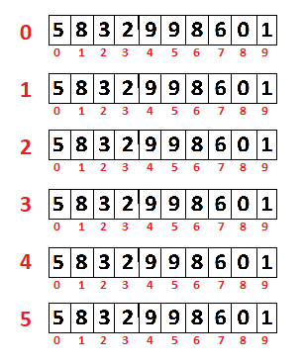
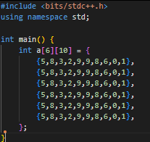
2D ARRAY

Slide 29
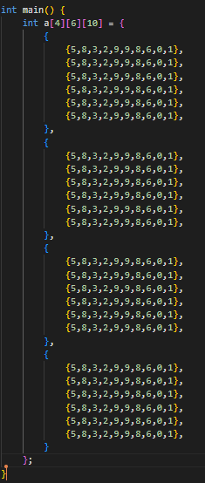
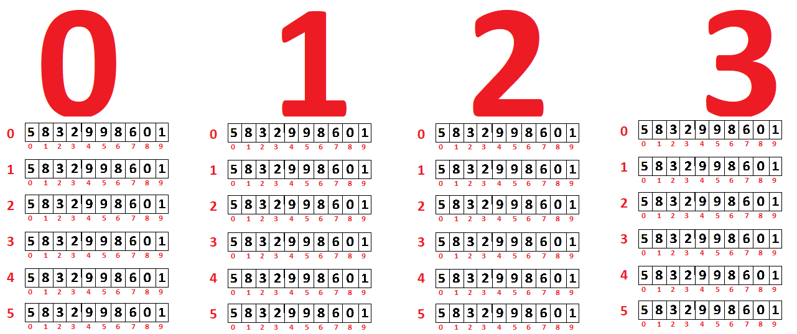
3D ARRAY

Slide 30
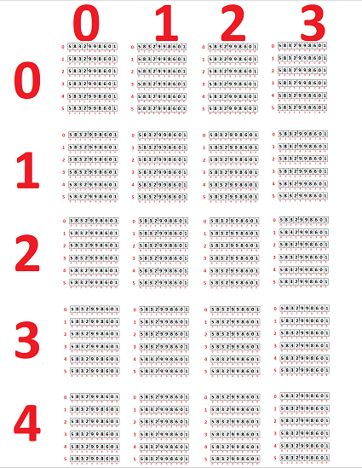
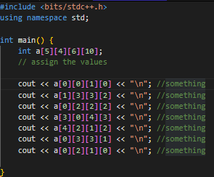
4D ARRAY

Slide 31
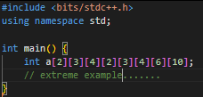
5D+ ARRAY

Slide 32
THANKS Q/A

